Slide 1
[NAME:Saunak Mukherjee] [TOPIC: FLIGHT PRICE PREDICTION]

Slide 2
FLIGHT PRICE PREDICTION
Customers who are seeking to get the lowest price for their ticket, while airline of the companies are trying to keep their overall revenue as high as possible and maximize their profit.
India which is the third-biggest avionics showcase in 2022 and the biggest by 2030.
From the customer point of view, determining the minimum price or the best time to buy a ticket is the key issue. The conception of ‘‘tickets which has bought in advance are the cheaper” is no longer working (William Groves and Maria Gini, 2013)

Slide 3
The higher the level of the competition, the weaker of a market power of the airline, & then the less likely the chance of the airline fare which has increases.
Tziridis et al. In his comparison, Bagging Regression Tree which is identified as the best model, the robust and not affected by using different input feature sets.
The presence of the LCC in a market has had a substantial impact of the total passenger volume and a air ticket price.

Slide 4
WEB SCRAPPING
selenium will be used for web scraping data from www.yatra.com
Flights on route of New Delhi to Mumbai in duration of 23 Jan 2022 to 4 Feb 2022.
Data is scrap in three categories:
Economy class flight price extraction
Business class flight price extraction
Premium Economy class price extraction
Selecting features to be scrap from website.
In next part web scraping code executed for above mention details. Exporting final data in Excel file.

Slide 5
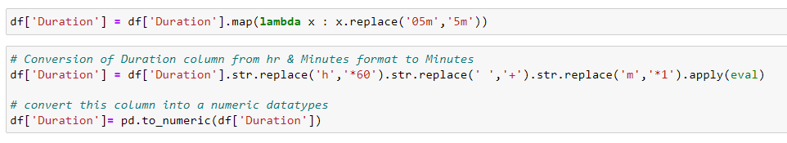
Conversion of Duration column from hr & Minutes format into Minutes .

Slide 6

New column for ‘Day’ & ‘Date’ is extracted from Date column.

Slide 7
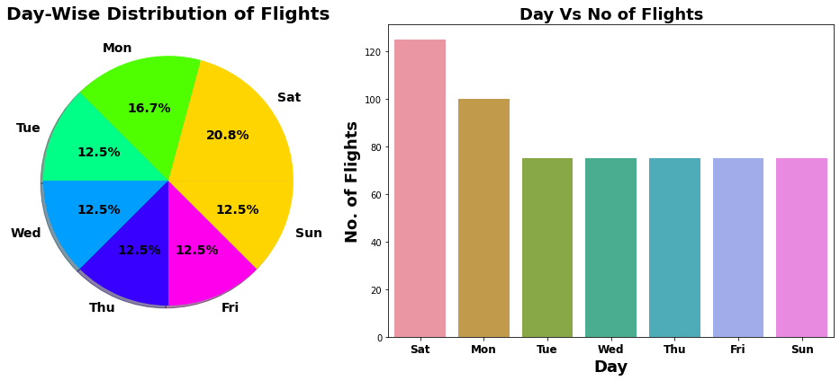
We can see maximum number of flights run by Vistara Premium Economy while minimum Flights run by SpiceJet. Around 25% of flights of Business Class.

Slide 8
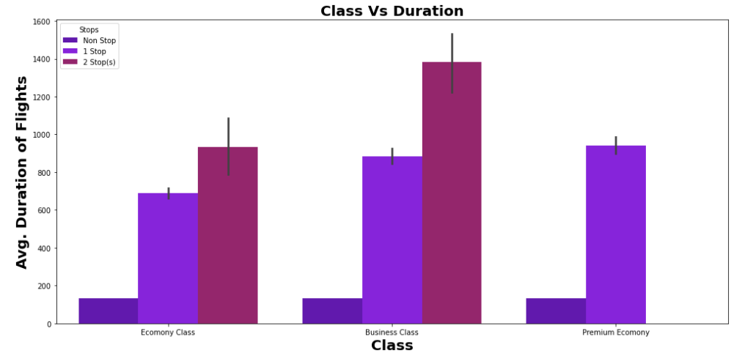
As Number of Stops increase the duration of flights increases.
As per Class of flight Maximum Avg. Duration of flight is for Business class.

Slide 9
IN This problem can be solve WE using the regression-based machine learning algorithm.
Methodology to Build Machine Learning Model:
Encoding Categorical data into Numerical data
Scaling data using Standard Scalar
Splitting data in training & test data using train_test_split from model_selection
Implementing various of the Regression Based Algorithm to build ML Model
Conducting 5 fold Cross validation
Hyper Parameter tuning of best Model
Saving Final Tuned Model using Joblib

Slide 10
THANK YOU

